Slide 1

Adroit E-KYC Software for Smooth and Paper Less Account Opening
ADROIT FINANCIAL SERVICES PVT LTD

Slide 2
E-KYC LOGIN PAGE
Login Company Website (https://www.adroitfinancial.com/) and choose open an account for online account opening.
Important Instructions
Location Should be Enabled in Device while opening a account for GEO-Tagging.
Kindly make sure All Security Pop-up are allowed for the purpose of documents fetching and E-signing.

Slide 3
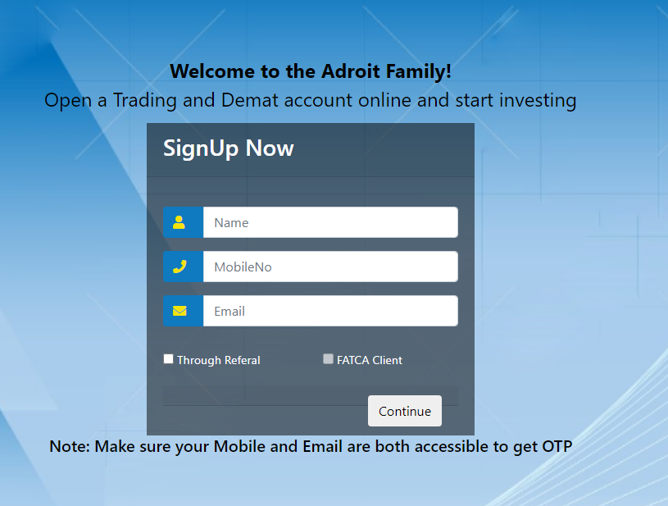
Enter Client’s Name , Mobile number & Email ID For OTP Verifications
Choose Referral in case the Account Source By AP
Ensure that Client’s Mobile Number or Email ID Should be Enabled on Aadhar Card.

Slide 4
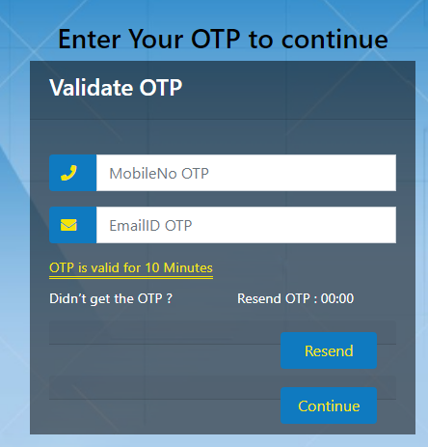
Enter OTP & Continue for Account Opening. (OTP VALID FOR 10 MIN)

Slide 5
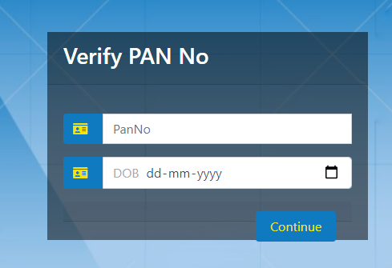
Enter Client’s Pan & Date Of Birth for Data Verification from Pan Card Website.

Slide 6
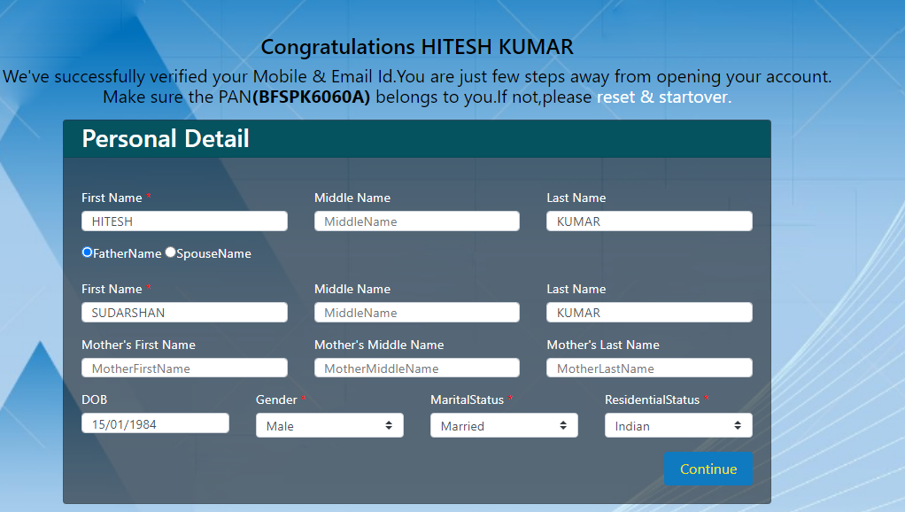
Client’s data will be fetched from KRA Agencies. If Client’s KRA not Updated in Any Agencies then client has to fill all require details without using any special characters.

Slide 7
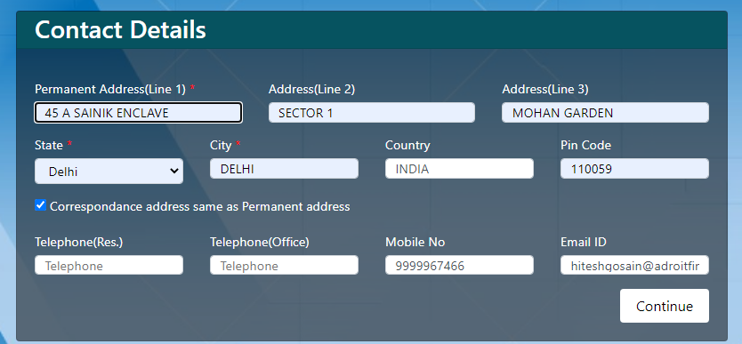
Enter Client’s Address , If Data Not Fetch from KRA Agencies.

Slide 8
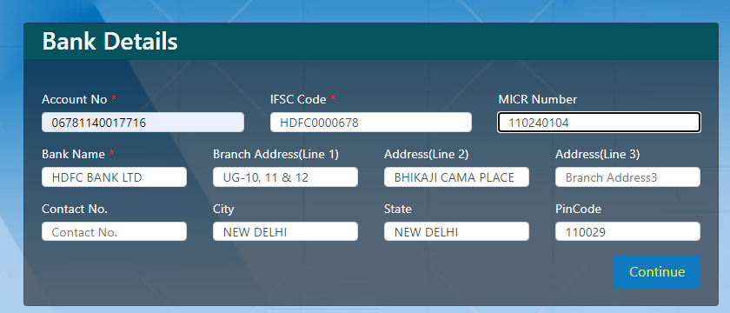
Note : Bank details will be Verified by Penny drop Systems
Enter Client’s Bank Details Along with IFSC & MICR Number

Slide 9
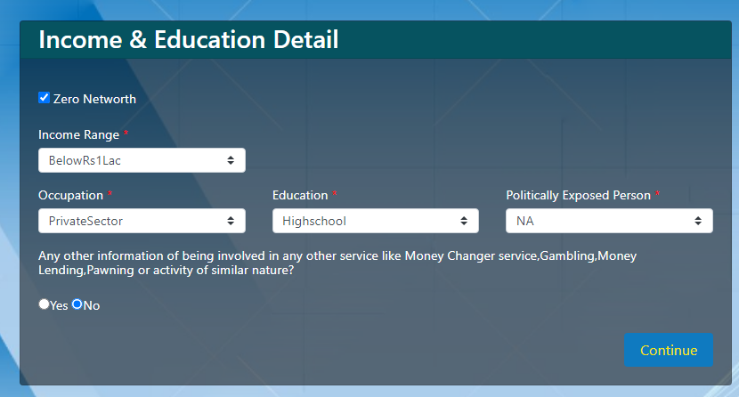
Select Client’s Income Range & Occupation , Education details on this page.

Slide 10
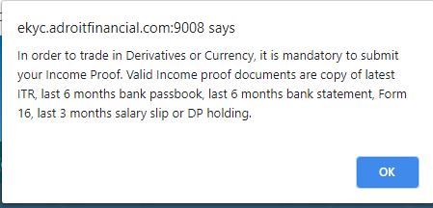
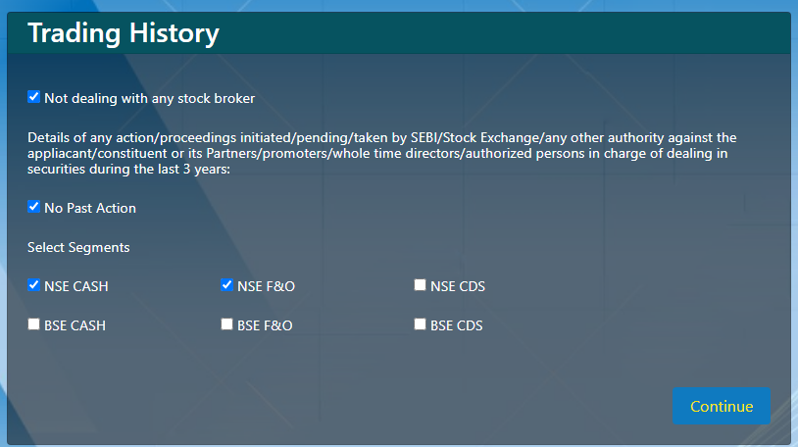
Select the Exchange As per Requirements and
In-case of Customer require any derivative exchange the client has to submit valid financial proofs.

Slide 11
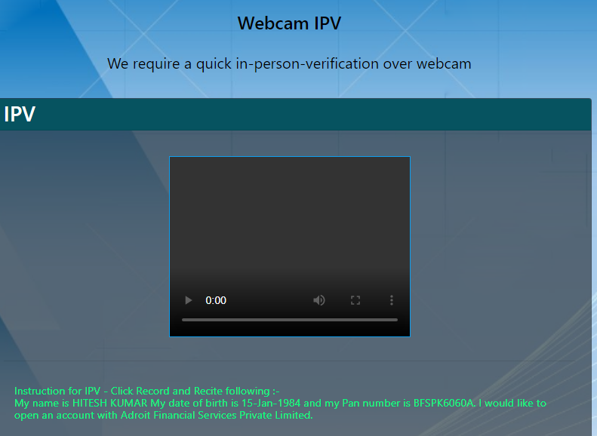
Now Client has to do In-Person Verification on this window
Client must have Camera & Head Phone for complete the process.
Client must read & record below showing instruction clearly for complete the in-person verification process.
First click on record then stop and do upload

Slide 12
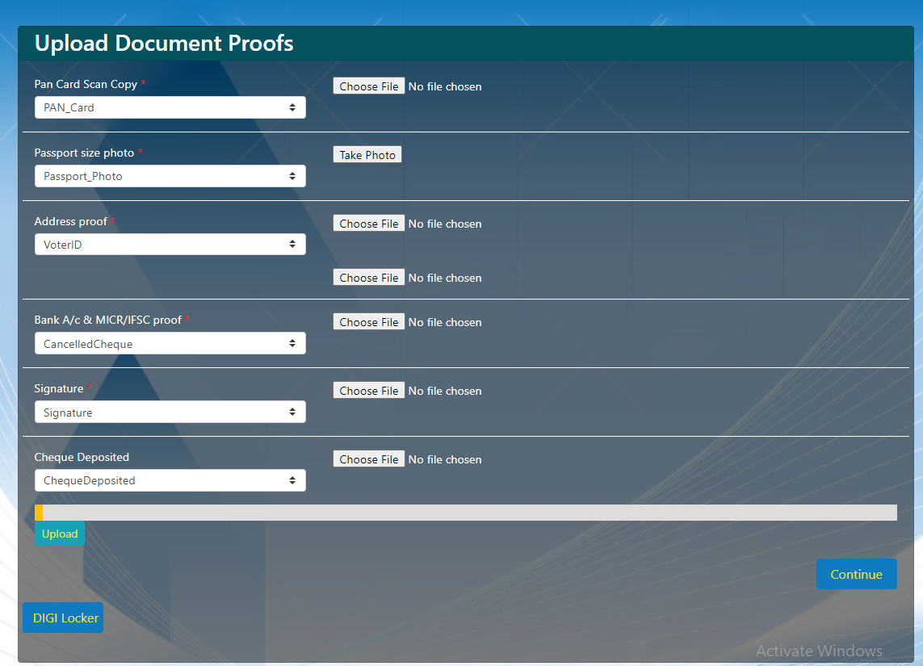
Pan card & Address proof must be fetched / verified from Digi locker Authority.
Client photo must be clicked by camera.
Signed cheque copy must be uploaded as bank proof.
Upload cropped signature in jpeg format and file size should not more than 10Kb.
If client name is not printed on cheque then please upload bank certified statement or passbook in cheque deposited field.

Slide 13
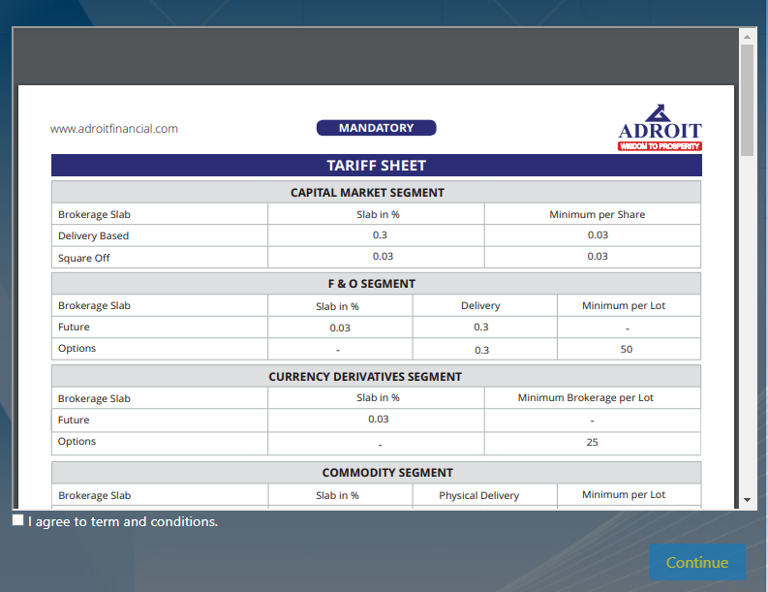
Tick and accept the terms and conditions (Brokerage & Dp Charges Schedule)
By default brokerage / Dp- charges mention on page, there is no modification allowed in the brokerage slab.
Client account will opened under Lifetime AMC scheme by default.

Slide 14
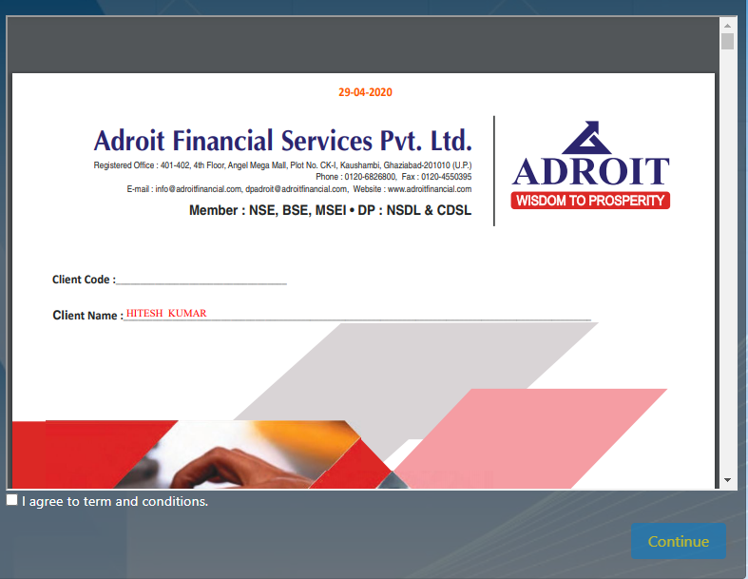
Client KYC form is ready & shown on the computer window before E-signing.
Client must read & insure all details are correct.
Then go for E-signing.

Slide 15
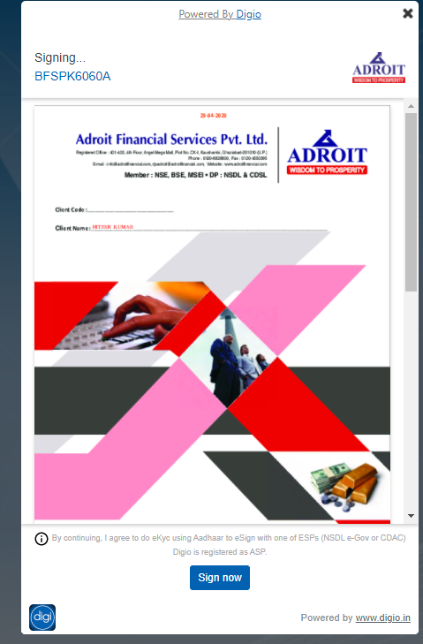
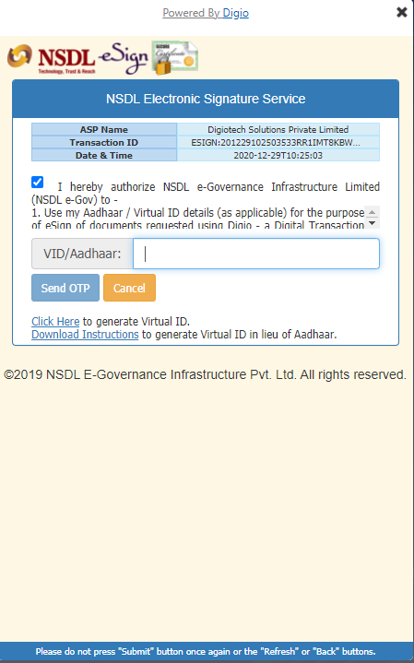
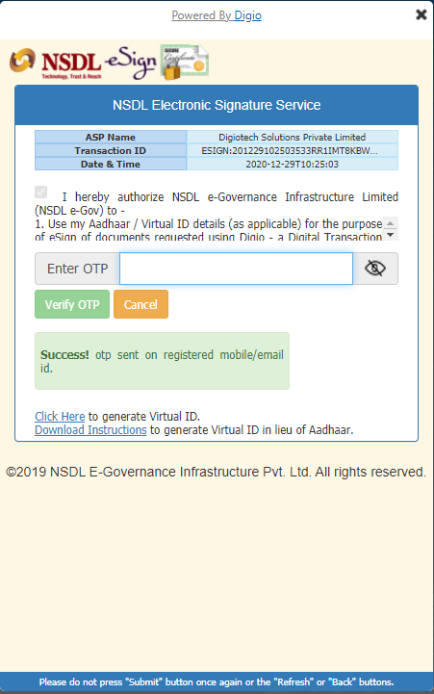
After acceptance client will received the OTP from UID for E-signing.
Then click on sign now
Tick on declarations.
Enter Aadhaar number for E-signing
Enter OTP and Submit for further process.
Verify OTP.

Slide 16
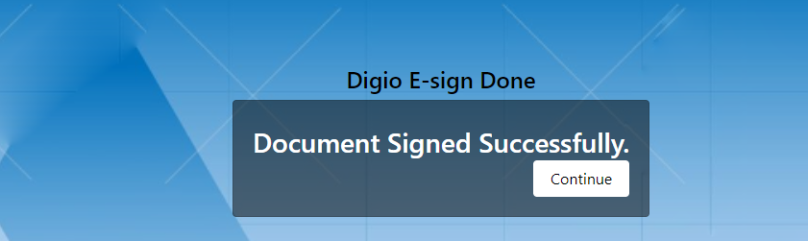
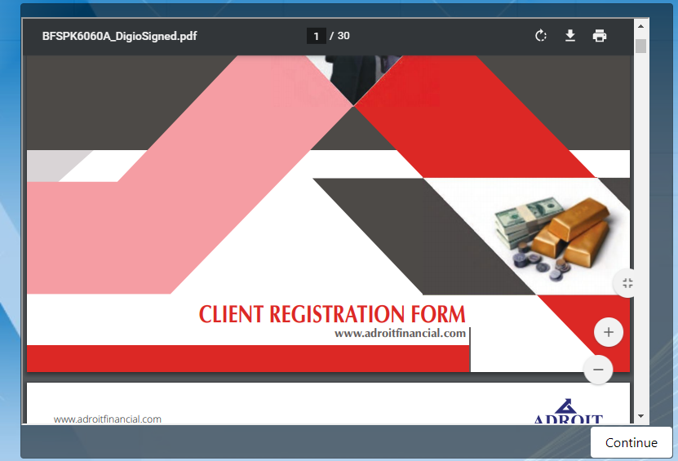
Click on continue for do the payments Rs 1180/- for account opening.
Then account opening request through E-sign is completed from client side.

Slide 17
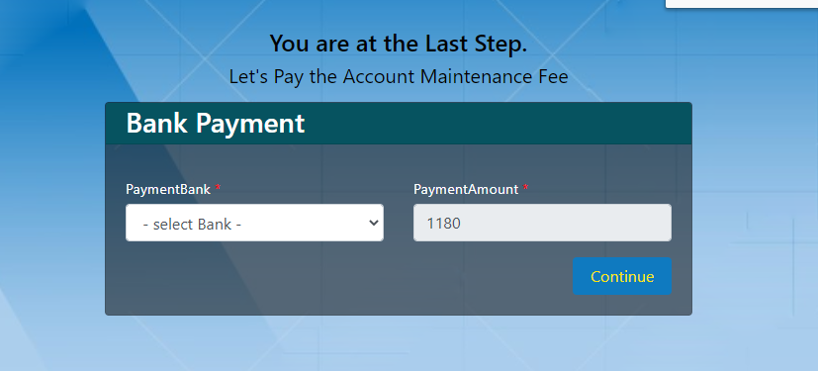
Payment Procedure for Account Maintaince charges.
Select a bank for fund transfer via Net-Banking.

